Slide 1

BookMates!
-GIVING BOOKS A SECOND LIFE
BATCH-10
231FA04658
231FA04688
231FA04598
231FA04G53

Slide 2
Agenda/Topics
Problem Statement
Scenario&Solution
Introduction
Main idea &Overview
Features
Existing system & Bookmates Advantages
Implementation
Tools used
References

Slide 3
“There is no friend as loyal as a book.”

Slide 4
Problem Statement

Slide 5
In the digital era, while reading remains a cherished activity, many people struggle to access the books they want due to high costs, limited availability, or a lack of community involvement. Reading is often overlooked due to busy schedules, lack of motivation, or difficulty finding a community of like-minded individuals. On the other hand, book lovers frequently struggle to find recommendations, connect with fellow readers, and stay engaged with their reading goals. Additionally, many individuals want to donate their books to a good cause but lack the proper channels to do so effectively.

Slide 6
Scenario

Slide 7
The Situation: Karthika is an active bookworm who is in a search of the an app that has all collection of books that she desires to read. She wants to donate a few of her books to someone in need and wants some books to read. She selects a collection of classic novels, educational books, and self-help guides.She also wants to get recommended and recommend some books.
The Problem: Karthika isn’t sure what to do about donating and purchasing the books. She’s also wants to join a book club community and attend events.
Solution: She gets to know BookMate app, Karthika discovers that there is a simple process for donating books. She can select the books she wants to donate, choose a cause (e.g., “Helping Students with Free Books” or “Supporting Literacy in Underserved Communities”), and the app will automatically match her donation with a recipient who has requested books in that category.She also joined a community.
Outcome: Karthika donates five books through the app. A week later, she receives a notification that one of her books, a classic novel, has been sent to a student who requested books for their school project. Karthika feels proud knowing her donation helped someone in need. She also feels encouraged to donate and purchase more books in the future, knowing the process is simple and impactful.She started attending events.

Slide 8
Main Idea
BookMates is a social platform where users can buy, sell, donate, or exchange books with others in their community or globally. The app fosters a reading culture, promotes book recycling, and connects book lovers through shared interests.

Slide 9
Introduction
The Bookmates app is a social platform designed for book lovers to sell, donate, or exchange books with others in their community. The basic idea revolves around:
Book Trading & Selling
Donation & Sharing
Community Engagement
Local & Global Reach
Wishlist & Requests

Slide 10
Overview
Notifications
User Registration & Profiles
Book Listings & Categories
Buying & Selling
Book Donation & Exchanges
Search & Recommendations

Slide 11
Features:
Core Features:
-Sell or Give Away for Free
-Book Exchange
-Donation Section
-Chat & Negotiation
User Features:
-User Profiles
-Book Condition & Reviews
-Location-Based Listings
-Delivery Options
Additional Features:
-Book Categories & Filters
-Trending & Featured Books
-Events & Meetups
-Notifications & Alerts

Slide 12
Existing System
In the current landscape, individuals rely on various traditional and
digital methods to buy, sell,exchange, or donate books.
However, these methods come with several limitations that
make the process inefficient and cumbersome.
Physical Bookstores & Libraries
Online Marketplaces (e.g., eBay, Craigslist, Facebook Marketplace)
Book Exchange Groups & Forums
Charitable Organizations & Book Donation Centers
Limitations of the Existing System:
Lack of a centralized and dedicated platform for book lovers.
Scattered listings across multiple platforms, making it hard to find books efficiently.
No structured exchange system for book swapping.
Inefficient communication between buyers, sellers, and donors.
Limited accessibility for underprivileged readers who rely on book donations.

Slide 13
Advantages:
The Bookmates app serves multiple purposes, benefiting individuals, communities, and even organizations. Here are its key uses:
1. Buying & Selling Books
2. Donating & Sharing Books
3. Book Exchange (Swapping)
4. Building a Community of Book Lovers
5. Access to Rare & Out-of-Print Books
6. Supporting Education & Literacy
7. Encouraging Sustainable Reading Habits

Slide 14
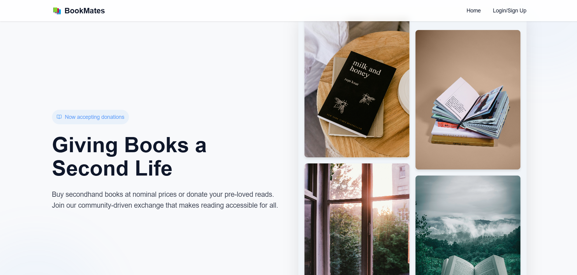
Implementation:
30%
50%
80%
Entertainment
Relaxation
Knowledge
Mercury is the closest planet to the Sun and the smallest of them all
Venus has a beautiful name and is the second planet from the Sun
Despite being red, Mars is actually a cold place. It’s full of iron oxide dust

Slide 15
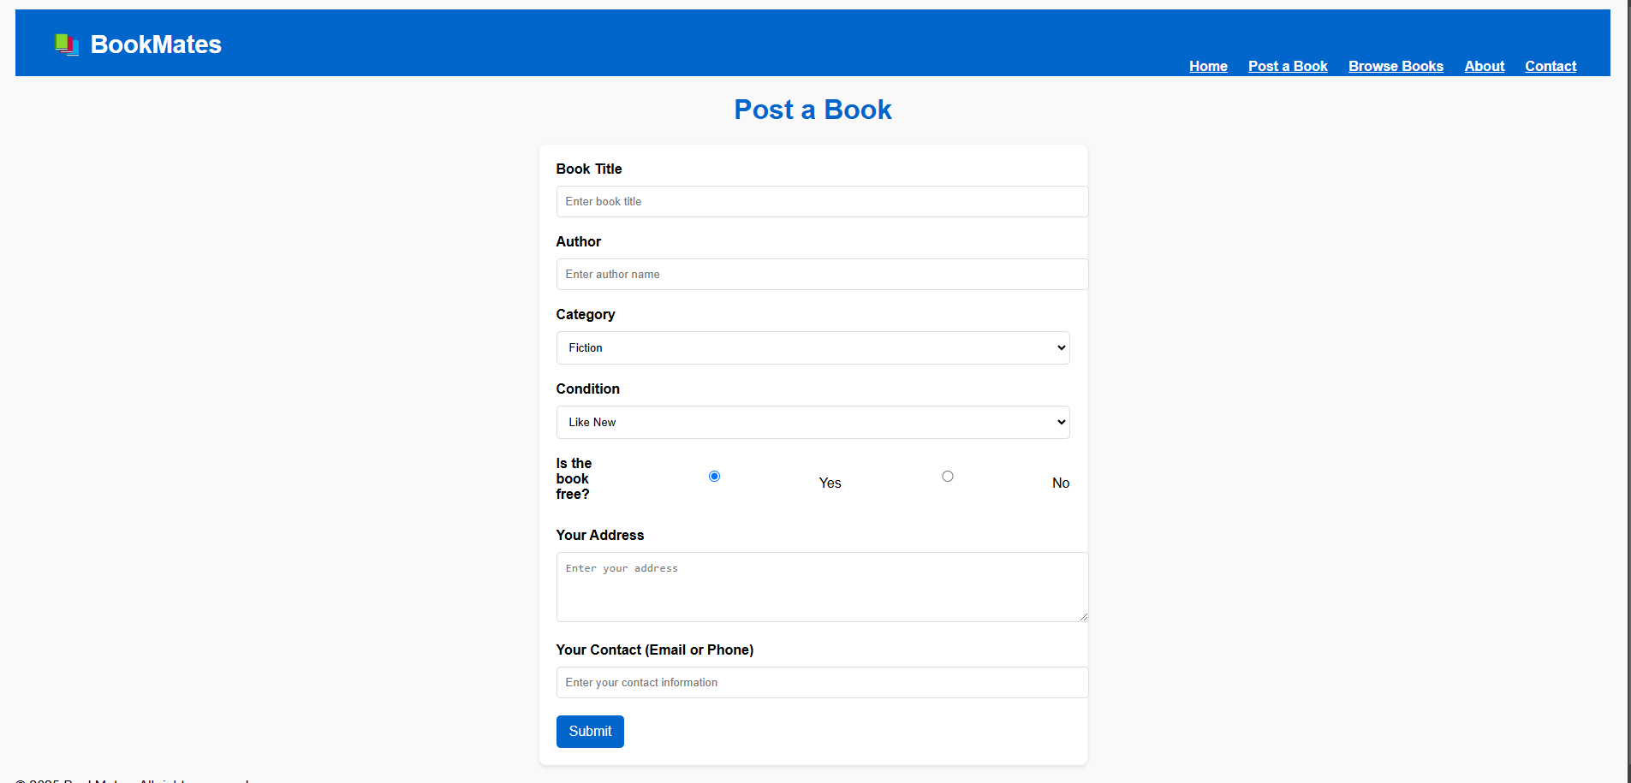

Computer mockup
You can replace the image on the screen with your own work. Just right-click on it and select “Replace image”

Slide 16
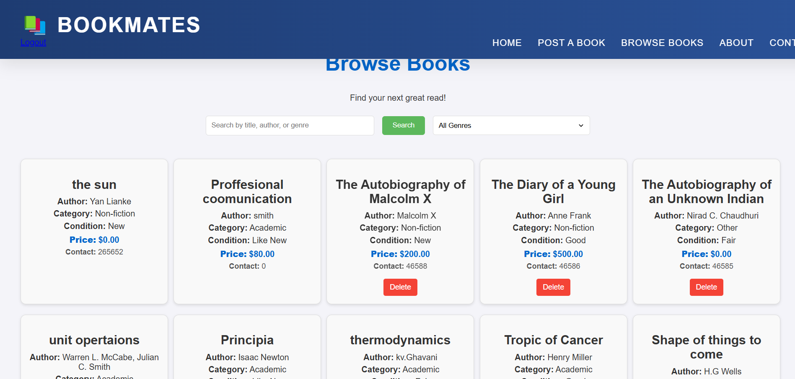

Tablet mockup
You can replace the image on the screen with your own work. Just right-click on it and select “Replace image”

Slide 17
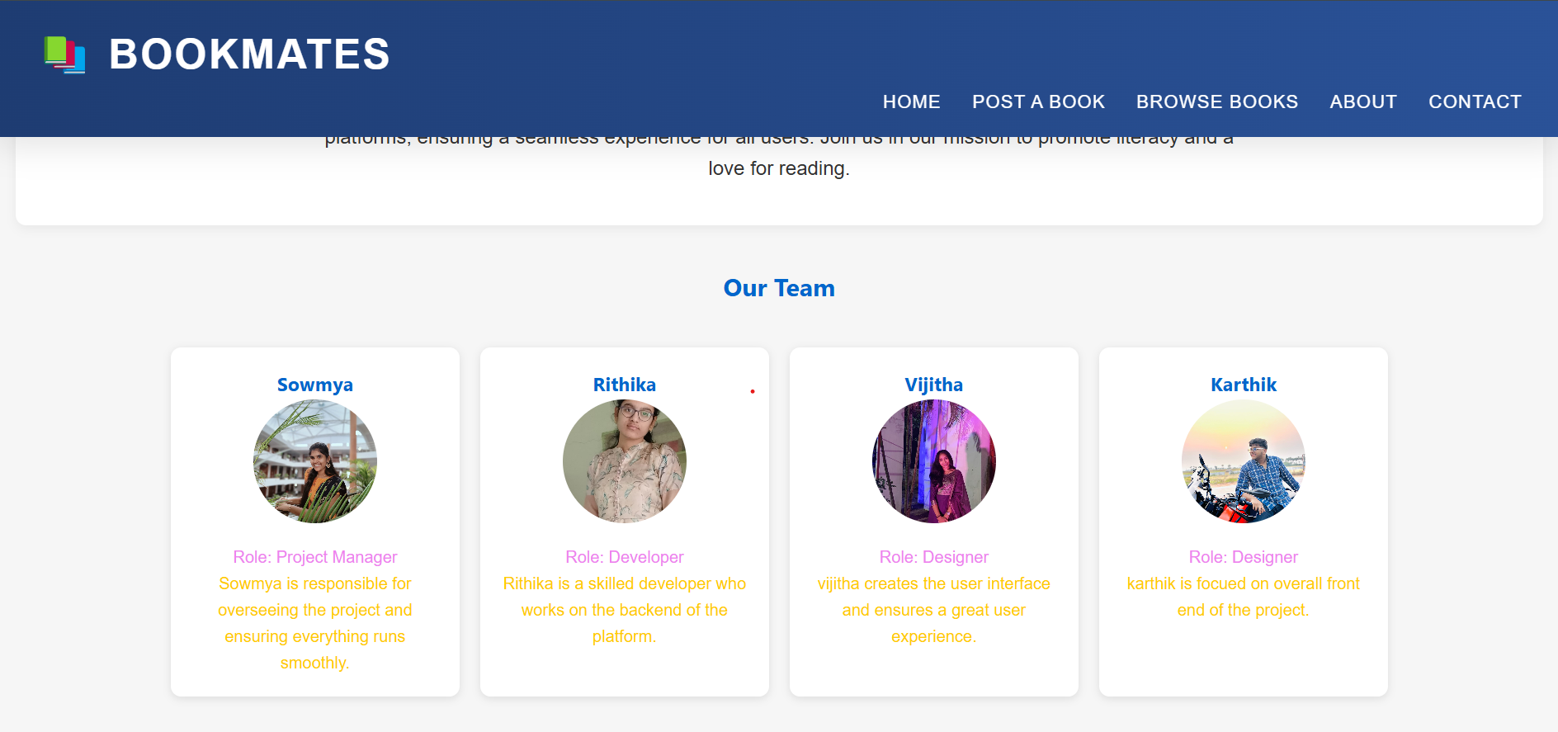
Table of contents
01
02
03
Introduction
You can describe the topic of the section here
Genres
You can describe the topic of the section here
Reading tips
You can describe the topic of the section here

Slide 18
Tools used
1.Software Components:
Front-End Development:
HTML/CSS/JavaScript: Create user interfaces for registration, resource mapping,
and alerts.
2. Back-End Development:
Server-Side Logic:
PHP,SQL
Database Management:
MySQL, or PostgreSQL: Store user profiles, resource data, and
inventory.
PHP: Create visual reports. Server-Side Scripts

Slide 19
3.Notifications and Alerts:
Push Notifications (Firebase Cloud Messaging, One Signal):
Send alerts to users.
SMS Gateways (Twilio, Nexon):
Send SMS notifications.
4.Security Measures:
Authentication (OAuth, JWT):
Secure user data.
Encryption (SSL/TLS):
Protect data during transmission.
Analytics and Reporting:
Data Visualization Libraries

Slide 20
References:
Designing an application like Book Mates, a book club or reading application, involves several aspects, including user interface (UI) design, user experience (UX), feature development, and system architecture. Below are some references and resources that can guide you in designing your Book Mates app:
1. UI/UX Design References:
UI Design:
Websites :Dribbble
:Behance
:UI Movement
B. UX Design Principles:
Books: "Don’t Make Me Think" by Steve Krug
: "The Design of Everyday Things" by Don Norman
Website: UX Design Process Guide
And many more references were taken for the application.

Slide 21
Future Enhancements
Supporting Independent & Self-Published Authors
-New authors can list their books for sale or donation.
-Helps independent writers reach a wider audience.
Personalized Book Recommendations
-Users get AI-powered book suggestions based on
their interests.
-Helps discover new authors, genres, and trending
books.
Launching an e-book feature

Slide 22
Summary
Book Mates is a social platform designed for book lovers to connect, share reading experiences, and discuss their favorite books. Users can create profiles, track their reading progress, join virtual book clubs, and receive book recommendations based on their preferences. The app fosters a sense of community by allowing users to interact, share reviews, and participate in discussions. With features like notifications for book releases, reading challenges, and the ability to donate books to others, Book Mates aims to make reading more enjoyable and accessible to everyone.

Slide 23
Thanks!
Please keep this slide for attribution

